Slide 2
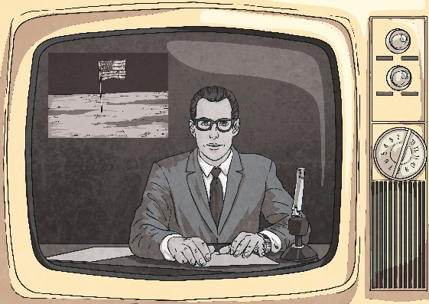
The Apollo 11 Mission
Imagine it is July 1969 and you have been excitedly following the build-up to the Apollo 11 mission.
It’s your job to write a newspaper report about the incredible event.
Time for lift-off!
Notes:
Disclaimer: This PowerPoint Presentation/resource contains links to external websites. Please check that the content of external links is appropriate for the intended audience. Twinkl Ltd is not responsible for the content of external links.

Slide 3
“We Have Lift Off!” 16th July 1969
Listen to the following recording.
Using the “We have lift off!” News Report Activity Sheet, identify the five Ws and pretend to be a news reporter introducing this exciting moment in history.
Notes:
Disclaimer: This PowerPoint Presentation/resource contains links to external websites. Please check that the content of external links is appropriate for the intended audience. Twinkl Ltd is not responsible for the content of external links.

Slide 4
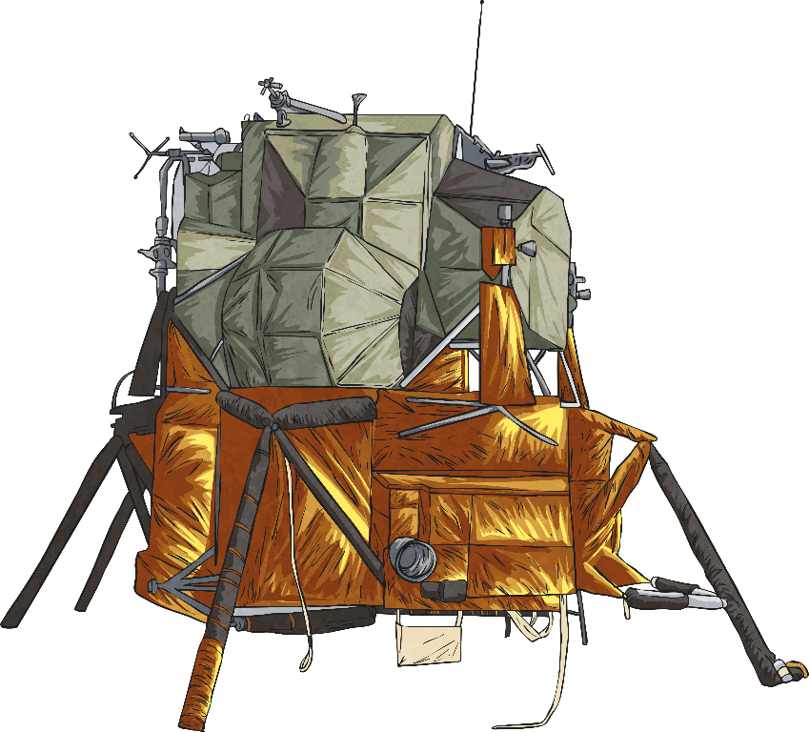
“The Eagle Has Landed.” 20th July 1969
Listen to the following recording.
Using the “The Eagle has landed.” Point of View Activity Sheet, describe what is happening at the point in the mission.
Notes:
Disclaimer: This PowerPoint Presentation/resource contains links to external websites. Please check that the content of external links is appropriate for the intended audience. Twinkl Ltd is not responsible for the content of external links.

Slide 5
“One Small Step…” 20th July 1969
Listen to the following recording.
How would you have felt?
What might you have said?
Notes:
Disclaimer: This PowerPoint Presentation/resource contains links to external websites. Please check that the content of external links is appropriate for the intended audience. Twinkl Ltd is not responsible for the content of external links.

Slide 6
“One Small Step…” 20th July 1969
Now watch this television footage.
Notes:
Disclaimer: This PowerPoint Presentation/resource contains links to external websites. Please check that the content of external links is appropriate for the intended audience. Twinkl Ltd is not responsible for the content of external links.

Slide 7
“One Small Step…” 20th July 1969
Watch the television footage again.
This time try to add some ideas to the One Small Step… Quotes Activity Sheet as you watch.
Notes:
Disclaimer: This PowerPoint Presentation/resource contains links to external websites. Please check that the content of external links is appropriate for the intended audience. Twinkl Ltd is not responsible for the content of external links.

Slide 8
Watching the Moon Landing
Imagine you are watching the Moon landing in 1969. Your task is to write a newspaper report about the important event.
With a friend, spend one minute discussing the features it should have.
Start
Notes:
Disclaimer: This PowerPoint Presentation/resource contains links to external websites. Please check that the content of external links is appropriate for the intended audience. Twinkl Ltd is not responsible for the content of external links.

Slide 9
Watching the Moon Landing
An effective newspaper report should include:
a headline and sub-headline
an introductory paragraph that includes the five Ws
facts about the main event
quotes written as direct speech and reported speech
written in the third person and past tense
a conclusion paragraph to explain what might happen next
Notes:
Disclaimer: This PowerPoint Presentation/resource contains links to external websites. Please check that the content of external links is appropriate for the intended audience. Twinkl Ltd is not responsible for the content of external links.

Slide 10
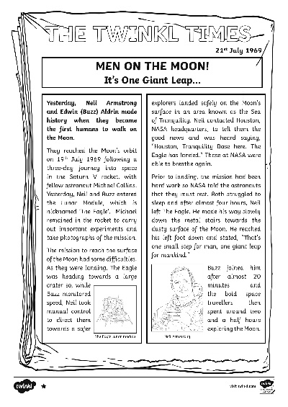
Watching the Moon Landing
Look at The Moon Landing Exemplar Newspaper Report to identify the features of a newspaper.
Notes:
Disclaimer: This PowerPoint Presentation/resource contains links to external websites. Please check that the content of external links is appropriate for the intended audience. Twinkl Ltd is not responsible for the content of external links.

Slide 11
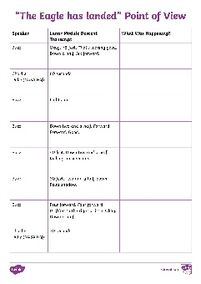
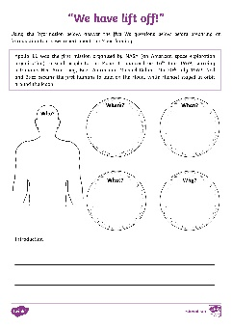
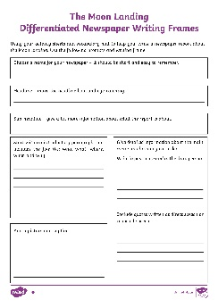
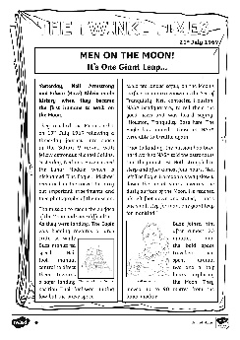
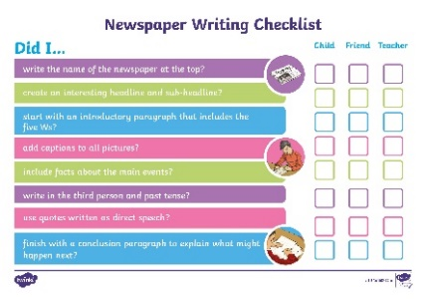
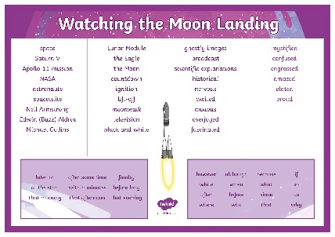
Newspaper Report Writing
Use The Moon Landing Differentiated Newspaper Report Writing Frame to organise your newspaper writing into paragraphs.
Remember to use the ideas and language from your
“We have lift off!” News Report Activity Sheet, “The Eagle has landed.” Point of View Activity Sheet, “One Small Step…” Quotes Activity Sheet, The Moon Landing Newspaper Report Vocabulary Mat and the Newspaper Report Writing Checklist.
Notes:
Disclaimer: This PowerPoint Presentation/resource contains links to external websites. Please check that the content of external links is appropriate for the intended audience. Twinkl Ltd is not responsible for the content of external links.

Slide 12
Show Me Where…
Read through a partner’s newspaper report. Show me where your partner has...
THE TWINKL TIMES
21st July 1969
MEN ON THE MOON!
It’s One Giant Leap…
The world watched on (well, nearly 600 million of us!) as yesterday, NASA astronauts, Mission Commander Neil Armstrong and Lunar Module Pilot Edwin (Buzz) Aldrin, made history when they became the first humans to walk on the Moon.
included an introductory paragraph;
written facts about the main event in chronological order;
used past tense and the third person;
included a quote written as direct speech or reported speech;
included a conclusion paragraph to explain what might happen next.
Notes:
Disclaimer: This PowerPoint Presentation/resource contains links to external websites. Please check that the content of external links is appropriate for the intended audience. Twinkl Ltd is not responsible for the content of external links.

