Slide 1
Adding ‘ed’
past tense
1. Just add ‘ed’
2. double last letter, then add ‘ed’
3. If the word ends in e’,
just add ‘d’
4. If the word ends in ‘y’,
drop the ‘y’ and add ‘ied’
DB 2012

Slide 2
Just add ‘ed’
jump
ed

Slide 3
Just add ‘ed’
call
ed

Slide 4
Just add ‘ed’
laugh
ed

Slide 5
Just add ‘ed’
turn
ed

Slide 6
Just add ‘ed’
want
ed

Slide 7

Just add ‘ed’
help
ed

Slide 8
Just add ‘ed’
sort
ed

Slide 9
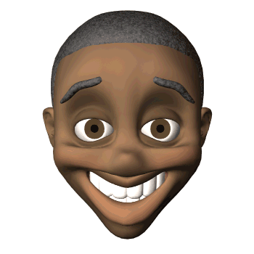
2. double last letter, then add ‘ed’
nod
ded

Slide 10
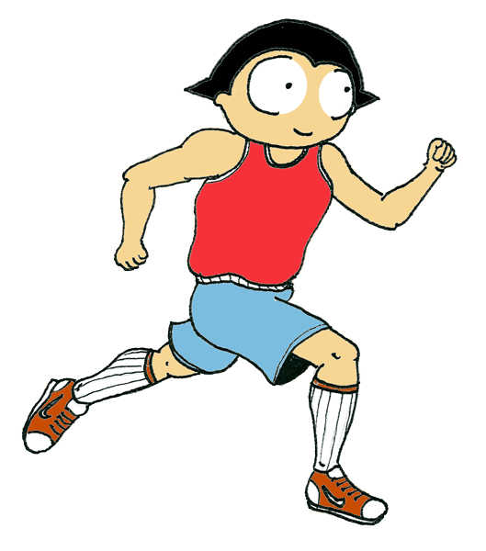
2. double last letter, then add ‘ed’
jog
ged

Slide 11
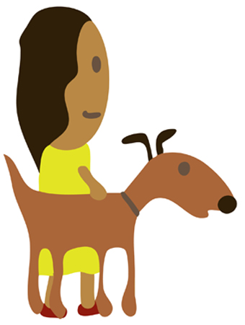
2. double last letter, then add ‘ed’
pat
ted

Slide 12

2. double last letter, then add ‘ed’
stop
ped

Slide 13
2. double last letter, then add ‘ed’
skip
ped

Slide 14

2. double last letter, then add ‘ed’
rip
ped

Slide 15

2. double last letter, then add ‘ed’
pop
ped

Slide 16
2. double last letter, then add ‘ed’
chat
ted

Slide 17

2. double last letter, then add ‘ed’
plan
ned

Slide 18

2. double last letter, then add ‘ed’
grip
ped

Slide 19
3. If the word ends in ‘e’, just ‘d’.
like
d

Slide 20
3. If the word ends in ‘e’, just ‘d’.
hike
d

Slide 21
3. If the word ends in ‘e’, just ‘d’.
bake
d

Slide 22
3. If the word ends in ‘e’, just ‘d’.
wave
d

Slide 23
3. If the word ends in ‘e’, just ‘d’.
cycle
d

Slide 24
3. If the word ends in ‘e’, just ‘d’.
time
d

Slide 25
3. If the word ends in ‘e’, just ‘d’.
frame
d

Slide 26
3. If the word ends in ‘e’, just ‘d’.
line
d

Slide 27
4. If the word ends in a ‘y’,
drop the ‘y’ and add ‘ied
ied
cr
y

Slide 28
4. If the word ends in a ‘y’,
drop the ‘y’ and add ‘ied’
sp
y
ied

Slide 29

4. If the word ends in a ‘y’,
drop the ‘y’ and add ‘ied’
dr
y
ied

Slide 30

4. If the word ends in a ‘y’,
drop the ‘y’ and add ‘ied’
fr
ied
y

Slide 31
4. If the word ends in a ‘y’,
drop the ‘y’ and add ‘ied
tr
y
ied

